Slide 1
Higher Biology
Metabolic Rate
Mr G R Davidson

Slide 2
Metabolic Rate
The metabolic rate of an organism is the amount of energy consumed in a given period of time.
It can be measured as:
Heat energy produced per unit of time
Oxygen used per unit of time
Carbon dioxide released per unit of time.

Slide 3
Metabolic Rate
A calorimeter can be used to measure metabolic rate.
The temperature of the water going in and the temperature of the water coming out are measured to give a rise in temperature.
This gives a rise in temperature over a period of time and this data can be used to calculate the metabolic rate.

Slide 4
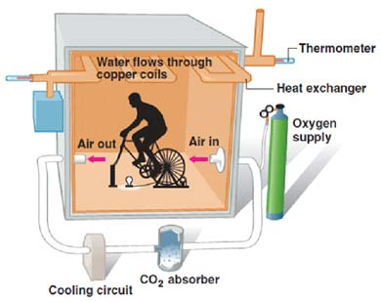
Calorimeter

Slide 5
Metabolic Rate
A respirometer can also be used to measure the metabolic rate of an organism.
This is a container in which an organism is placed along with a chemical to remove CO₂.
The volume of oxygen consumed by the organism can be seen as coloured liquid moves through a capillary tube to replace the oxygen.

Slide 6
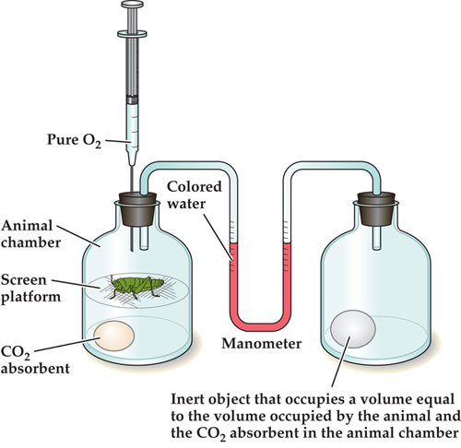
Respirometer

Slide 7
Oxygen Delivery
As the rate of aerobic respiration increases so does the demand for oxygen.
Therefore it is important that the cells have access to oxygen through an efficient transport system.
In vertebrates the oxygen is delivered in blood which is pumped by the heart.
Vertebrates all have a closed circulatory system.

Slide 8
Oxygen Delivery
This means the blood is kept in a continuous loop of blood vessels.
The heart pumps blood out into the largest of the vessels.
These vessels get progressively smaller until they become capillaries.
Capillaries have thin walls and this allows oxygen to be exchanged with the cells surrounding the capillary.

Slide 9
Single Circulatory System
Single circulatory systems are found in fish.
They are single because the blood only passes through the heart once for each body circuit.
Blood is pumped from the heart to the gills at high pressure, where it will receive its oxygen.
It then travels to the body tissues at low pressure where it will give up its oxygen.

Slide 10
Single Circulatory System
Gill capillaries
ventricle
heart
atrium
Body capillaries

Slide 11
Incomplete Double Circulatory System
A double circulatory system has blood flowing through it twice for each body circuit.
In amphibians and reptiles the system in incomplete as there are two atria but only one ventricle.
The right atrium receives blood returning from the body tissues.

Slide 12
Incomplete Double Circulatory System
The left atrium receives blood returning from the lungs.
The ventricle receives blood from both atria.
This results in some mixing between oxygenated and deoxygenated blood.

Slide 13
Incomplete Double Circulatory System
In amphibians this mixing isn’t too much of a problem as the blood returning from the body has been partially oxygenated by the moist skin of the organism.
In reptiles, mixing is reduced by the presence of a septum which partially divides the ventricle.

Slide 14
Incomplete Double Circulatory System
lung capillaries
right atrium
left atrium
heart
ventricle
body capillaries

Slide 15
Complete Double Circulatory System
A complete double circulatory is found in mammals and birds.
It is described as complete because the heart has 2 atria and 2 ventricles and the blood passes through the heart twice for each body circuit.
This means there is no mixing of the blood and so makes this system the most efficient.

Slide 16
Complete Double Circulatory System
lung capillaries
right atrium
left atrium
heart
right ventricle
left ventricle
body capillaries

Slide 17
Circulatory Systems
Vertebrate | Type of Circulation | Heart | Features
Fish | Single | 2 chambers | Low pressure
Amphibians & Reptiles | Incomplete double | 3 chambers | Tissue blood not completely oxygenated
Mammals & Birds | Complete double | 4 chambers | Good pressure and complete oxygenation

Slide 18
Lung Complexities
Amphibians can use their skin to exchange gases.
They can also use their mouth cavity.
They have lungs which are very inefficient due to a very small surface area.
They will usually only use their lungs during vigorous activity.

Slide 19
Lung Complexities
Reptiles and mammals have a breathing system containing many branching tubes ending in many alveoli.
These alveoli have very thin walls and are moist to increase the efficiency of gas exchange.
This provides plenty of oxygen for aerobic activities.

Slide 20
Lung Complexities
Birds are the most active group of vertebrates, needing even more oxygen than the other vertebrates.
They have additional air sacs over and above the lungs.
These are designed to keep more air flowing through the lungs.

Slide 21
Physiological Adaptations for Low Oxygen Niches
There are some animals which can survive in low oxygen environments such as high altitude, under water, etc..
Humans function best at sea level where the oxygen content of the air is about 20%.
However, at high altitudes, the air is thinner and contains less oxygen.

Slide 22
Breathing in Birds

Slide 23
Physiological Adaptations for Low Oxygen Niches
The body responds by increasing the number of red blood cells.
This makes up for the less oxygen in the air and allows the blood to carry the oxygen it needs.
The process of making the extra blood cells takes a few weeks.

Slide 24
Physiological Adaptations for Low Oxygen Niches
Bloodworms live in mud which contains very little oxygen.
To help them survive in this environment, they have haemoglobin in their body cells which can absorb any available oxygen from their surroundings.

Slide 25
Physiological Adaptations for Low Oxygen Niches
Marine mammals need to be able to dive for long periods and also be able to cope with increasing pressure as they go deeper.
To achieve this they can slow down their heart rate which helps them conserve oxygen.
Another adaptation they have is the ability to collapse their lungs which reduces their buoyancy.
This allows the animal to conserve energy which can then be used in the hunt for food.

Slide 26
Maximum Oxygen Uptake
The maximum volume of oxygen that an individual can take up during vigorous exercise is called the maximum oxygen uptake or VO₂ max.
VO₂ max is used as a measure of cardiovascular fitness in humans.
The person needs to be fitted with a carbon dioxide and oxygen analyser.

Slide 27
Maximum Oxygen Uptake
They then exercise on an ergometer such as a treadmill or exercise bike.
The VO₂ max is reached when the oxygen consumption stays steady even when the workload is increased.
The VO₂ max can be improved with training.

Slide 28
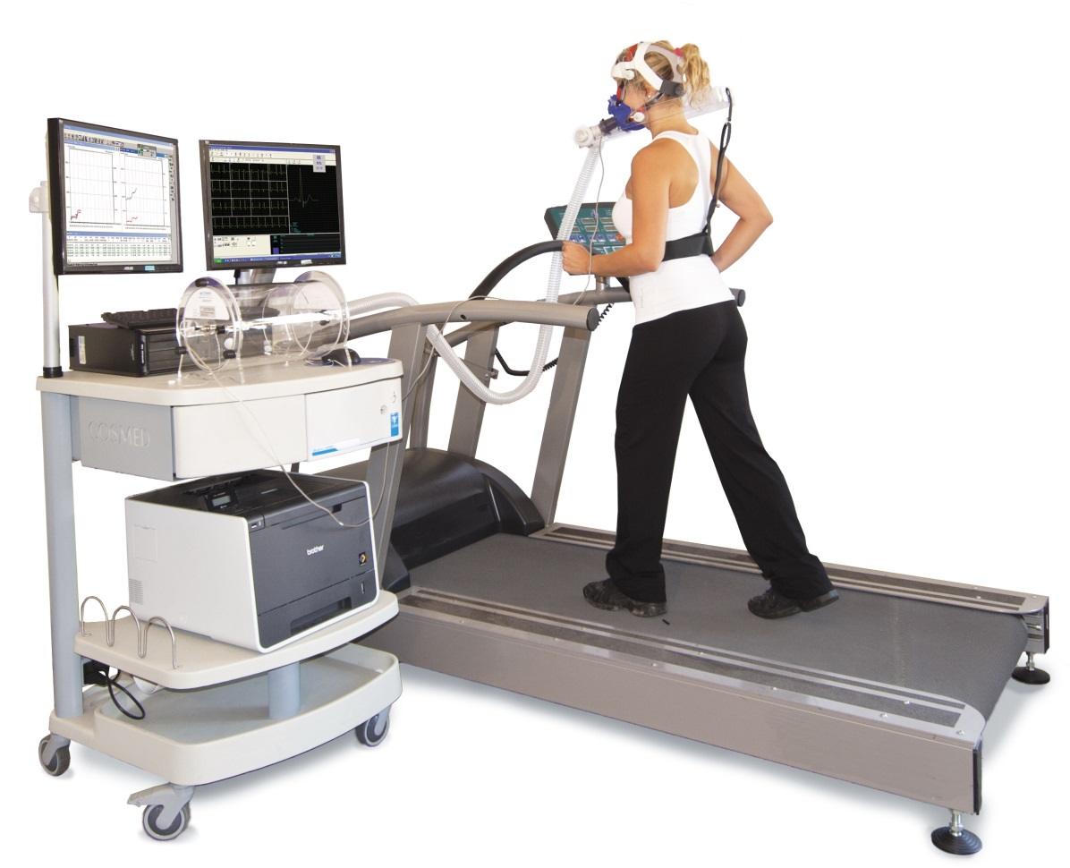
Measuring VO₂ max

